Slide 1







Capstone Project
Discover Security Vulnerabilities in IT Services
Presented by: Thirumaal.T
Course: Cyber Security

Slide 2
Project Scope
TechNest LLC is a leading software solutions provider in Silicon Valley, California. During the past few months, TechNest LLC’s clients such as Zero Bank and Mutillidae have been facing cyberattacks. These attacks led to a loss of critical client data.
Our team from TechNest LLC has been assigned to perform VAPT on
1. Zero bank’s network
2. Mutillidae’s Website
3. Mutillidae’s Database

Slide 3
Contents
1. Objective
2. VAPT on Network Infrastructure of Zero Bank
1) Centralized Directory Service
2) Server Logging Service
3) Zero Bank's Website
4) Remote Access Service
3. VAPT on Mutillidae Web Application
1) SQL Injection
2) Cross-site scripting

Slide 4
Contents contd.
3) Cross-site Request Forgery
4) Insecure Direct object
3. VAPT on Mutillidae Database
1) SQL Injection manual
2) SQL Injection Automatic

Slide 5
Objective
Perform VAPT on Zero banks’s Network
For VA (Vulnerability Assessment) the tool used is Nessus to scan systems present in the network, from the report generated from Nessus the vulnerabilities are listed. PT (Penetration Test) is performed by knowing the vulnerabilities of the machines present in the network.
Perform VAPT on Mutillidae Application
The tool used to perform VA for mutillidae application is Zaproxy and reports are generated. PT is performed with information gathered. The web application have many vulnerability the selected are performed for the project.

Slide 6
Objective Contd.
Perform VAPT on Mutillidae Database
Tool used for VA is Zaproxy to scan the vulnerability and to get in-depth detailed about web application’s vulnerability. PT is performed using SQLmap to retrieve data from database.

Slide 7
What is VAPT and Why?
Vulnerability Assessment and Penetration Testing (VAPT) is a term used to describe security testing that is designed to identify and help address cyber security vulnerabilities.
The evolving tools, tactics and procedures used by cybercriminals to breach networks means that it’s important to regularly test organization's cyber security.
VAPT helps to protect the organization by providing visibility of security weaknesses and guidance to address them.

Slide 8


Tools used to conduct Penetration Testing
Kali Linux
Nmap
SQLmap
Zaproxy
Setoolkit
Metasploit framework
Rsyslog
Jxplorer
Burpsuite

Slide 9



1. VAPT on Network Infrastructure of Zero Bank

Slide 10
Zero bank's infrastructure
Sno. | Machines | Information | IP’s
1. | Centralized Directory | Windows Server 2019 (domain.local) | 192.168.50.58
2. | Log Server | Ubuntu | 192.168.50.111
3. | Website of Zero Bank | http://zero.webappsecurity.com/login.html
4. | Windows Client (PC: WIN-7-Victim) | Username: STACK-WIN7 | 192.168.50.60

Slide 11
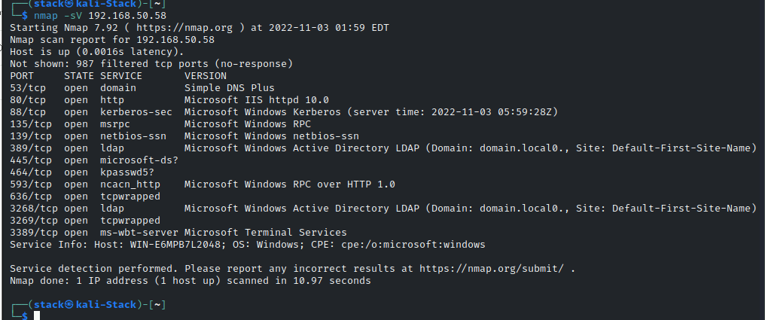
1) Centralized Directory Service
A directory service is a database for storing and maintaining information about users and resources. The CDS used here is Ldap.
i. Kerberos Information Disclosure
Nmap Scan reveals ports are opened and services used.

Slide 12
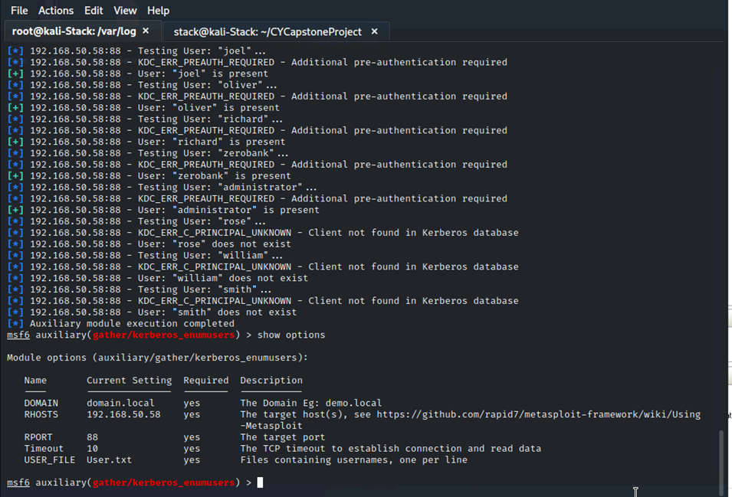
The Zero bank is using Kerberos for user authentication, by MITRE ATT&CK T1558.003 Kerberos is vulnerable and it is a common attack used by attacker to gain access to organization internal network.
From Metasploit Framework using Kerberos_enumusers to perform kerbrosting exploit, the IP obtain from Nmap scan is used to set, user list is also provided and exploit is ran. The exploit will compare the user list and Kerberos users from the machine.

Slide 13
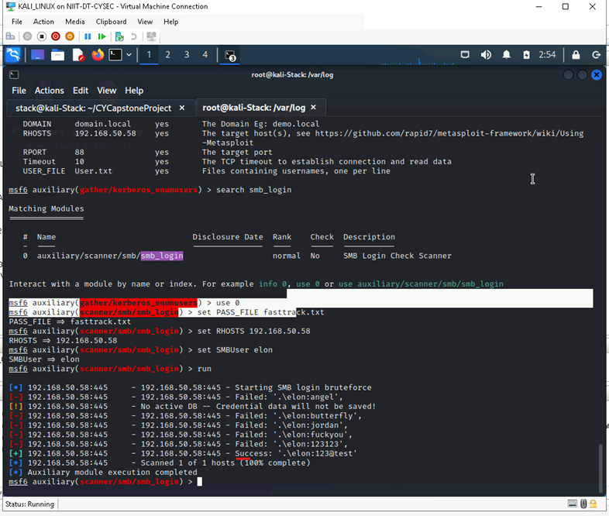
ii. Brute forcing with SMB
From Nmap scan the port SMB is opened by using brute force by providing username from kerberos and password list, the password is obtained.
The exploit smb_login is used and parameters are given for the exploit and the password is retrieved.

Slide 14
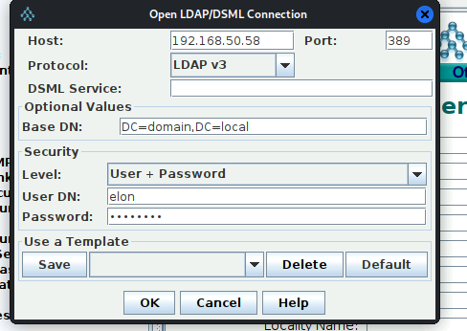
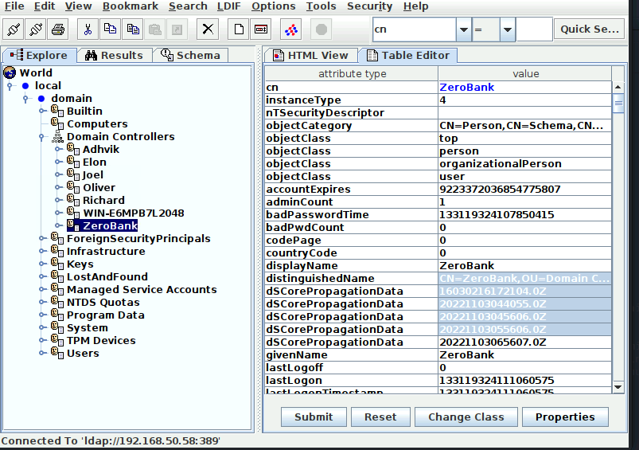
iii. Ldap enumeration using JXplorer
Jxplorer is a fully functional LDAP client with advanced security integration. With Jxplorer we can do search, navigate, modify contents. Easily to edit subtrees, read directory’s schema.
In below, the Jxplorer configuration and result is available.

Slide 15
Prevention
Rename Administrator as any other name.
Secure port 88, 445, 389 using managed access control list in firewall or router.
Manage access permissions to service accounts.
Configure IPS with rule set to prevent attacks.
Enable Audit policy for accounts logon (logs-wazuh).
Configure Logon Hours (Example: 10AM to 5PM).
Use strong passwords with special characters, longer than 10 but recommended is 14.
Apply Password expiry Policy (Change every 90 Days).
Limit service accounts to minimal required privileges (don’t use default configuration).

Slide 16
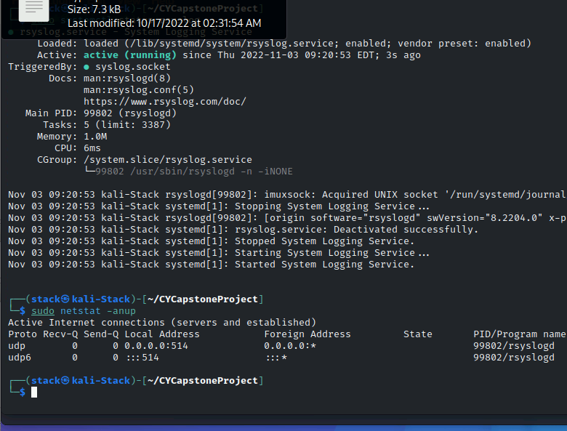
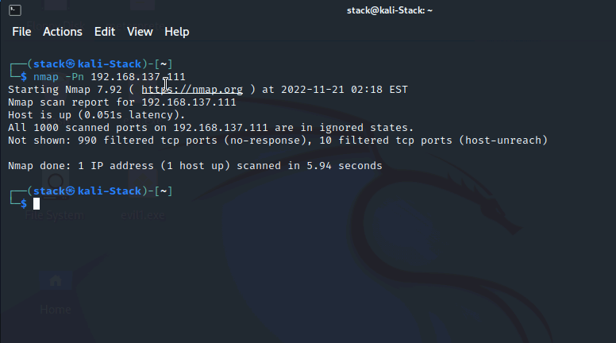
2. Remote Logging Service
Rsyslog is capable of forwarding logs to remote servers. The configuration is relatively simple and makes it possible for Linux admins to centralize log files for archiving and troubleshooting. The net-scan result shows the port 514 is open and the logs are ready to fetch from the port in Kali.

Slide 17
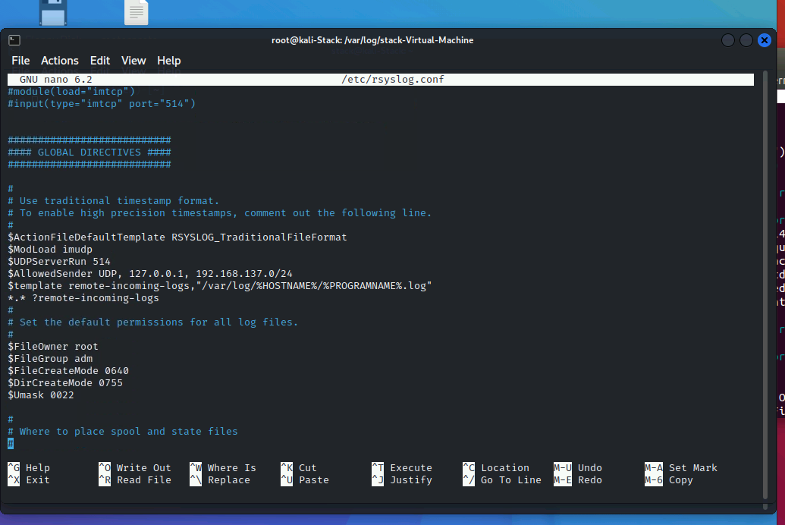
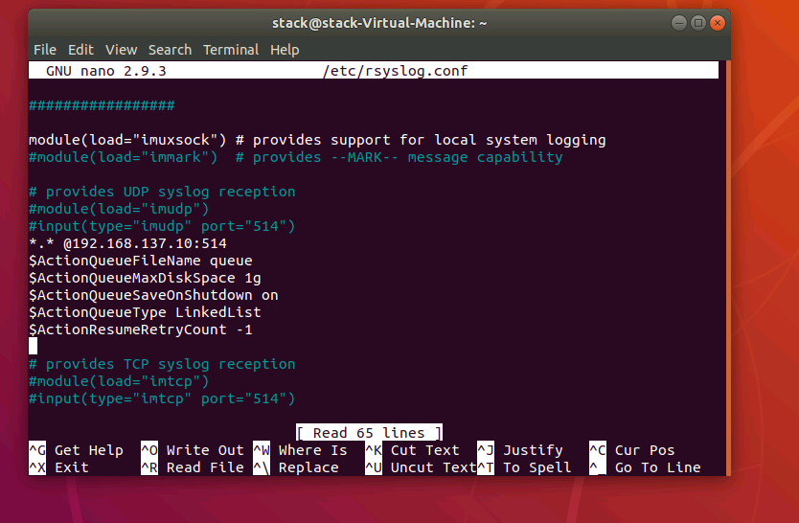
These are the configuration are made to obtain logs.

Slide 18
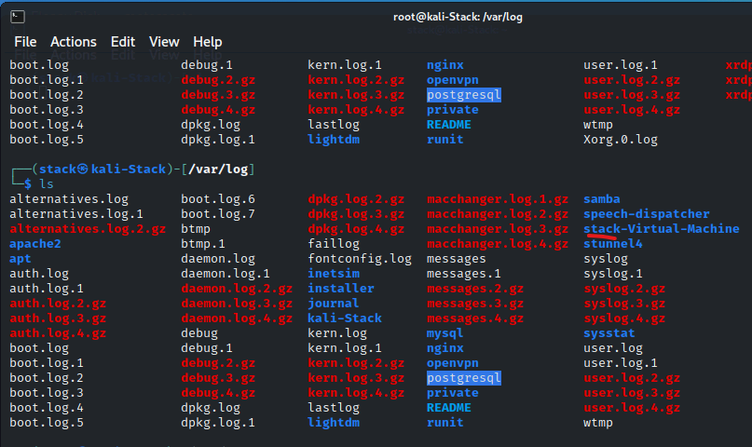
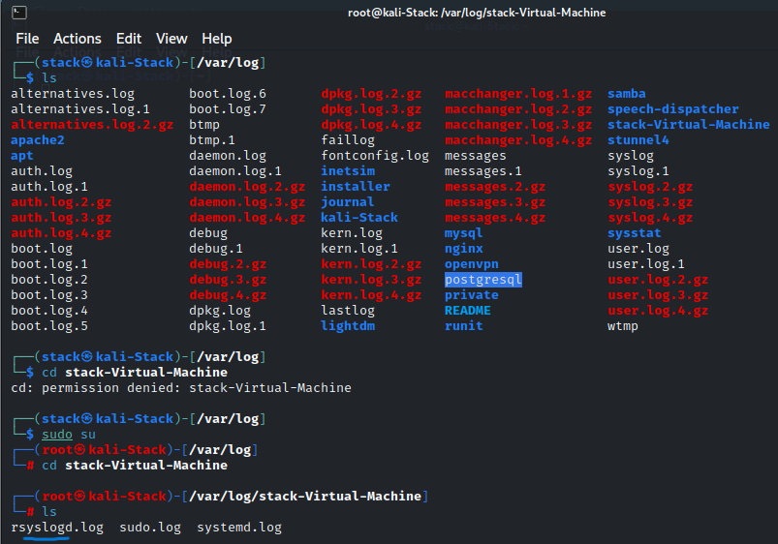
The logs are transferred from client to server machine.

Slide 19
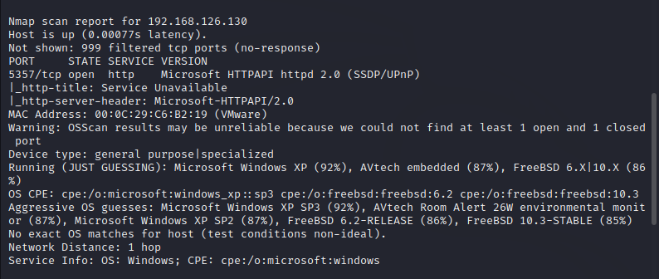
3. Web Application
In web application social engineering attack is performed, it is used for a broad range of malicious activities accomplished through human interactions. It uses psychological manipulation to trick users into making security mistakes or giving away sensitive information. Social engineering attacks happen in one or more steps.
The Nmap scan shows the victim pc’s IP.

Slide 20
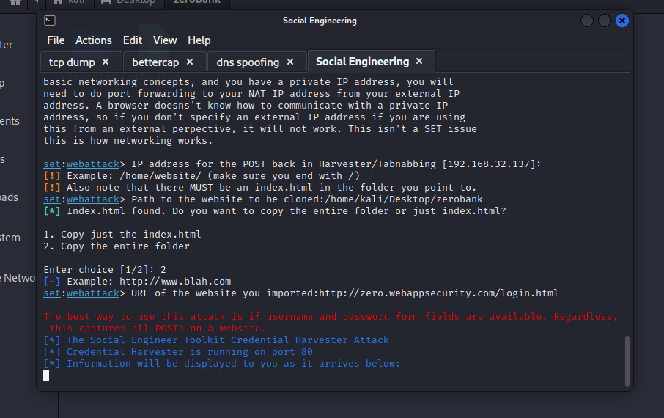
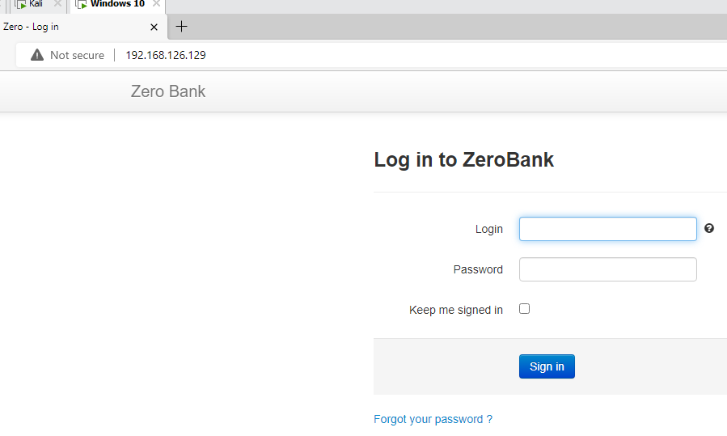
Using setoolkit the site can be cloned or we can use html file created us also. The IP of kali machine is accessed from victim, the login page is visible if the victim enter credentials setoolkit will capture.
Notes:
Harvest Credewntials

Slide 21
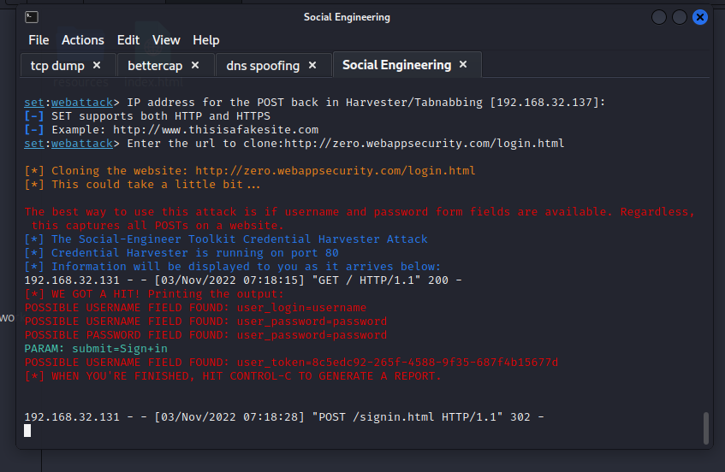
The login page is visible if the victim enter credentials setoolkit will capture.

Slide 22
Prevention
Multi-Factor Authentication.
Verify Email Sender’s Identity (https://email-checker.net/).
Verify Website (https://www.ionos.com/tools/website-checker)
Use SSL Certificate (TLS 1.3).
Get anti-phishing add-ons (Netcraft Extension).
Use strong passwords with special characters, longer than 10 but recommended is 14.
Password expiry Policy (Change every 90 Days).

Slide 23
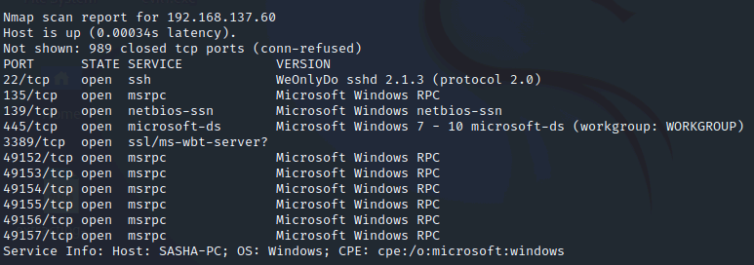
4. Remote Access Service
Remote access is the act of connecting to IT services, applications, or data from remote location, same location. This connection allows users to access a network or computer remotely via the internet.
Scan from Nmap shows the machine was equipped with vulnerable software. The access to the machine via ssh is easy no password require.

Slide 24
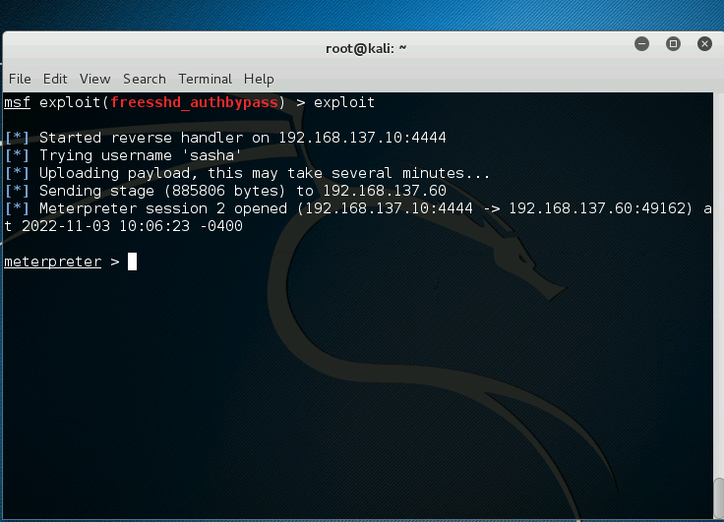
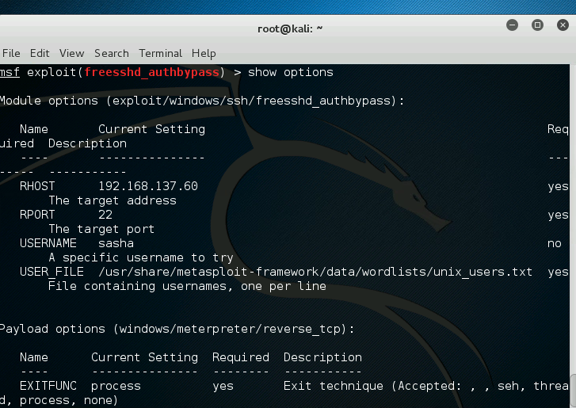
From CVE-2012-6066 freessd is vulnerable to bypass authentication. The exploit authbypass from metasploit framework is used to gain meterpreter shell. First rhost is set, if we have username it will be an advantage and then run the exploit.

Slide 25
Prevention
Update the freesshd, software patches have been applied for latest or use solar putty.
Update to windows 10 or 11 to get the system protected.
Deny access permissions to accounts through ACL.
Use IPS to prevent attacks.
Configuring Audit service for accounts for Endpoint Detection and Response (logs-wazuh).
Jump off server or Bastion server.
Use Legitimate Antivirus software to prevent attack.

Slide 26
2. VAPT on Mutillidae Web Application

Slide 27
Mutillidae Web Application
Sno. | Machines | Information | IP’s
1. | Metasploitable (Multtildae Web Application) | http://192.168.137.60/mutillidae/index.php | 192.168.137.63

Slide 28
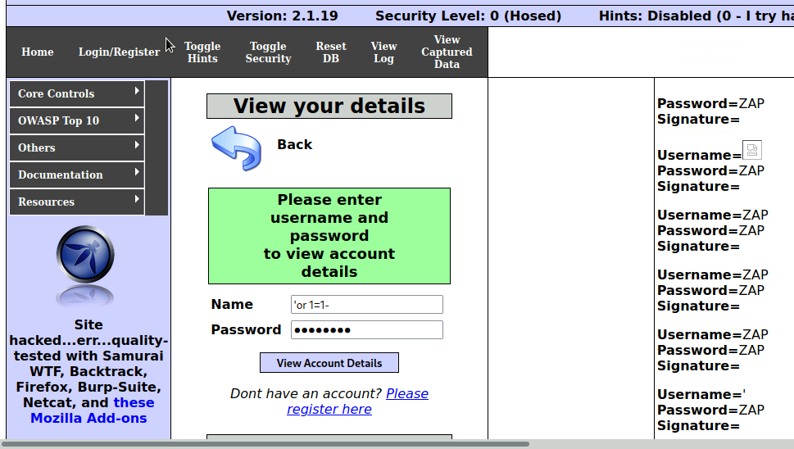
1. SQL Injection
SQL Injection attack happens when attacker exploits the vulnerability of fillable field. The attacker put malicious statements in the field. Impact of SQL injection is access to database, alteration of user information, deletion of data, passwords can be stolen.
The Boolean expression a type of blind SQL injection is performed to retrieve data, the expression used here is ‘or 1=1-

Slide 29
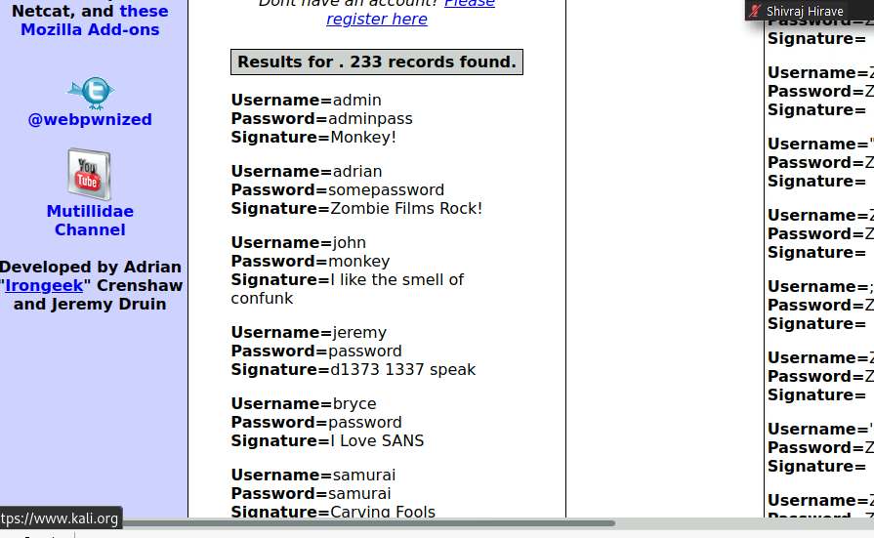
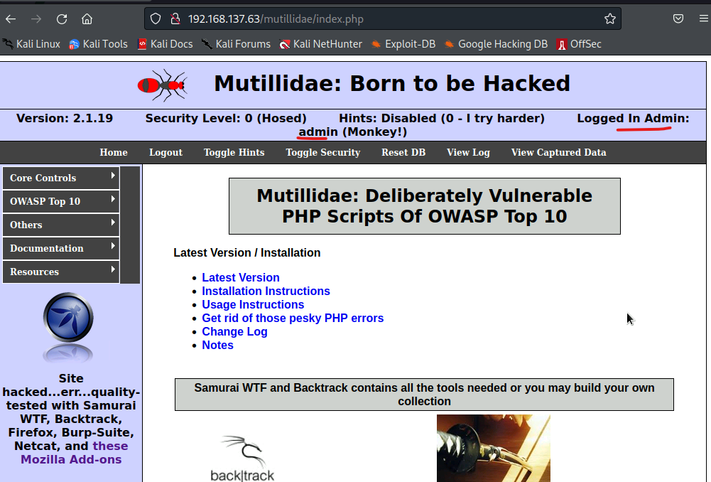
By using Boolean expressions we are able to retrieve the user credentials. With the credential we are able to login as admin.

Slide 30
2. Cross-site scripting
Cross site scripting attack is an injection type attack, generally found in web application. XSS vulnerability is used by attacker to bypass the access control policy.
The reflected XSS injection is performed, it will reflect in web server as an error message and this is not persistent.
Example of reflected XSS is given below https:insecurewebsite.com/status?message=All+is+well. <p>Status: All is well</p>

Slide 31
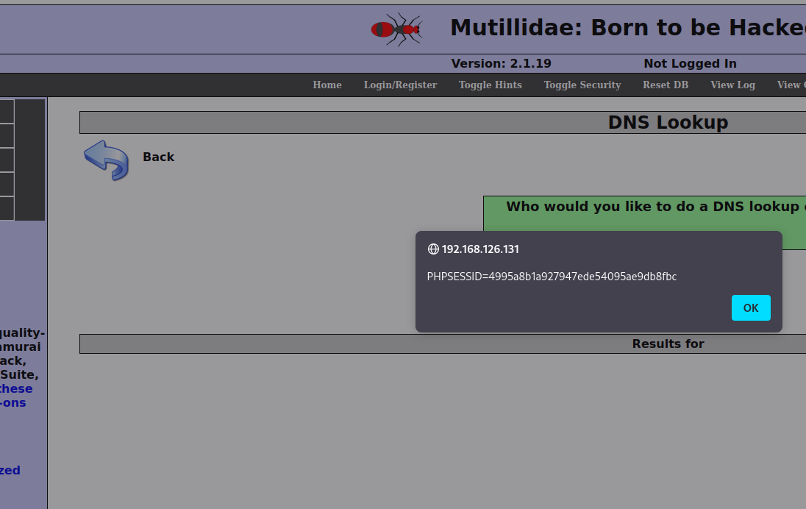
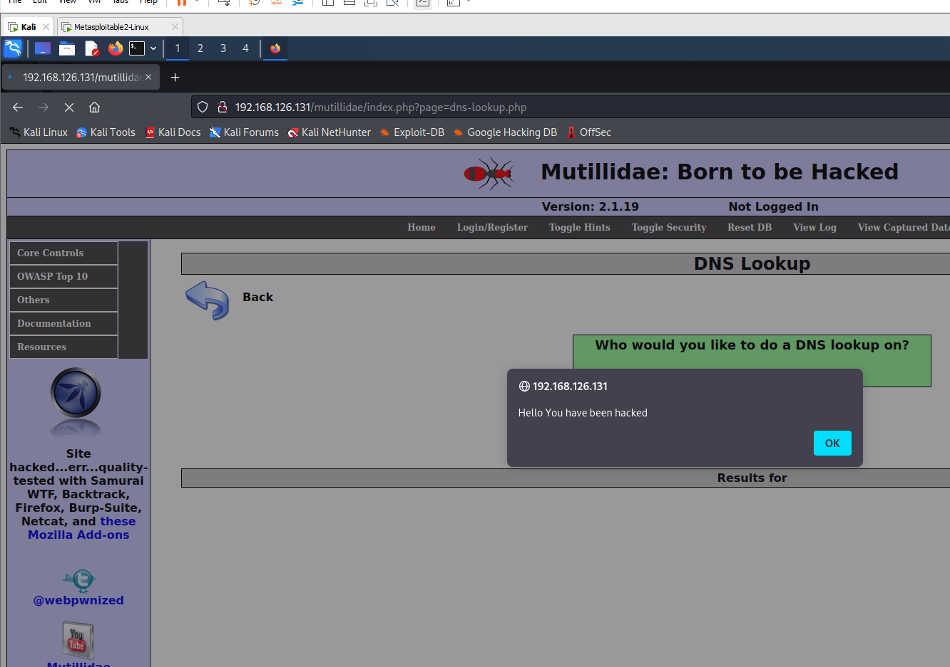
In OWASP top 10 XSS vulnerability is available. From DNS lookup there is one field to enter values, in that <script>alert(“Hello, You have been hacked”)</script> is used to display any information attacker thinks, <script>alert(document.cookie)</script> is to display cookie information of the browser.

Slide 32
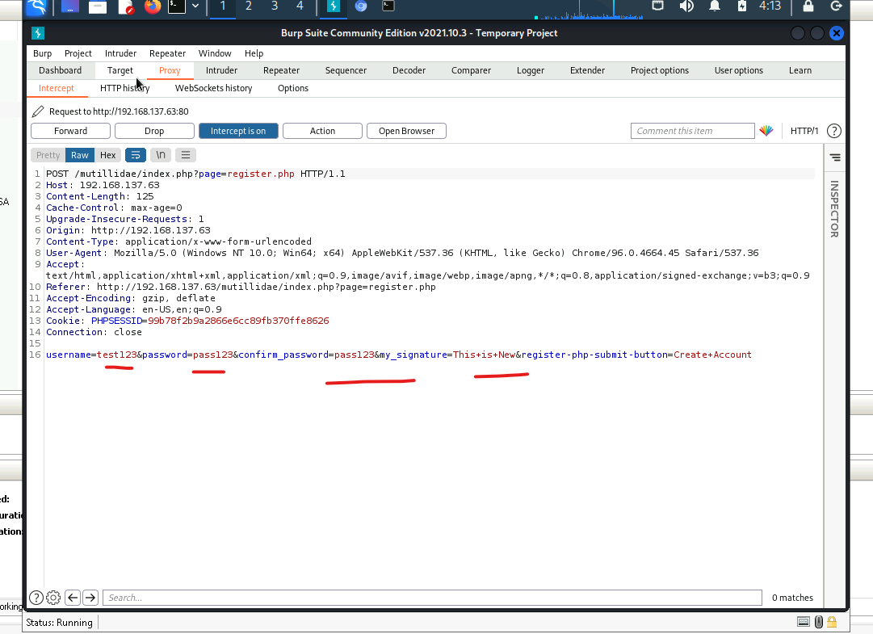
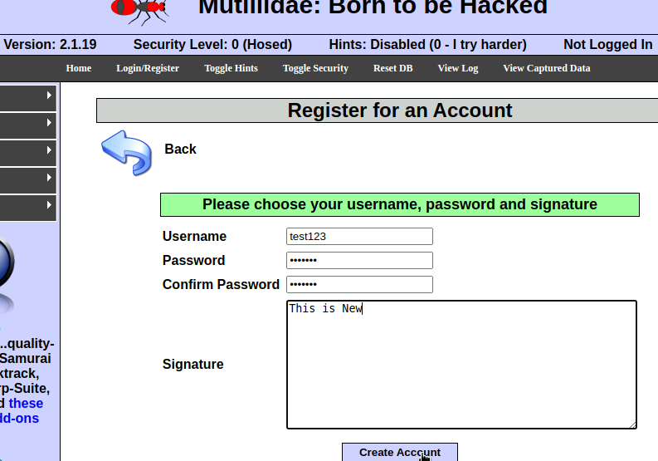
3. Cross site request forgery
Cross-Site Request Forgery (CSRF) is an attack that forces an end user to execute unwanted actions on a web application in which they’re currently authenticated.
The registration is done in the mutillidae web-application those information are captured by burp suite.

Slide 33
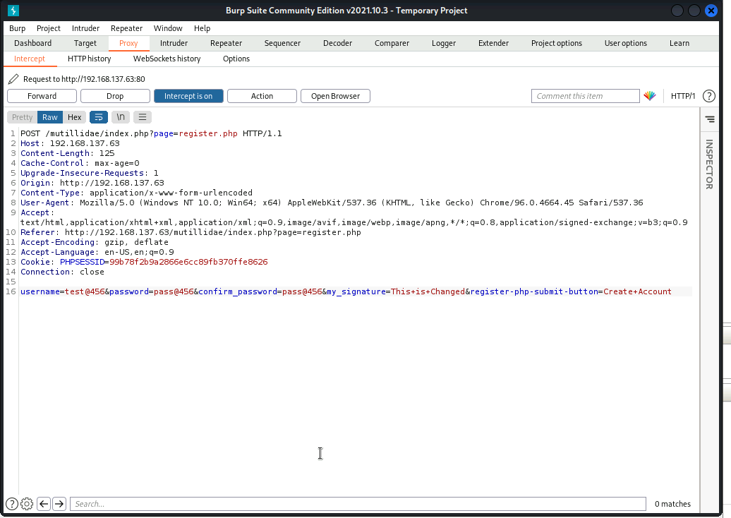
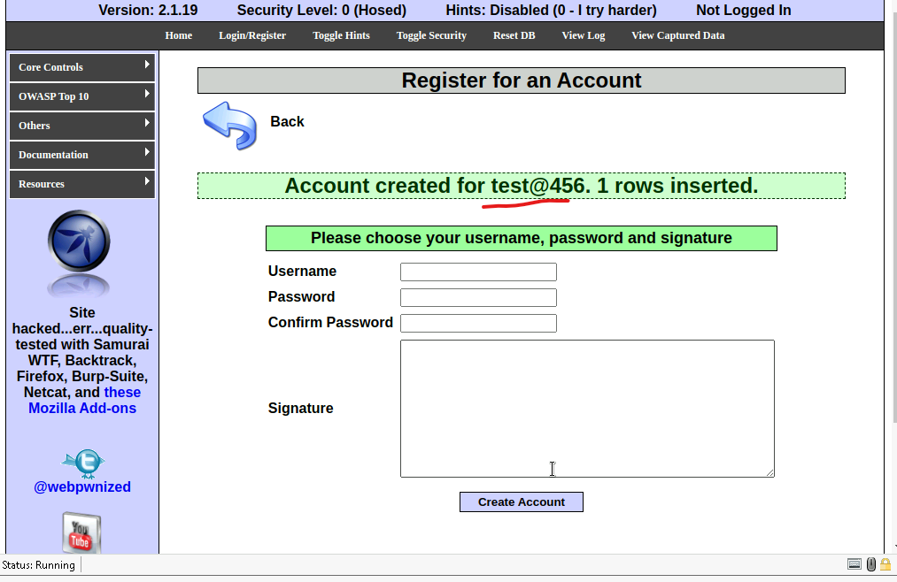
The information provided are changed in burpsuite and it is reflected in the registration also.

Slide 34
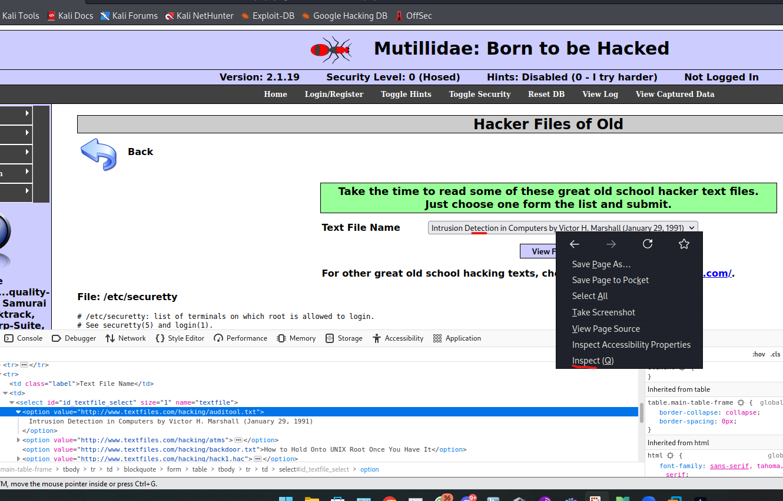
4. Insecure direct object
Insecure direct object reference (IDOR) is a type of access control vulnerability in digital security. This can occur when a web application or application programming interface uses an identifier for direct access to an object in an internal database but does not check for access control or authentication.
From text file name dropdown is an insecure direct object which uses identifier for direct access. we can inspect element and view the files which readable in the server.

Slide 35
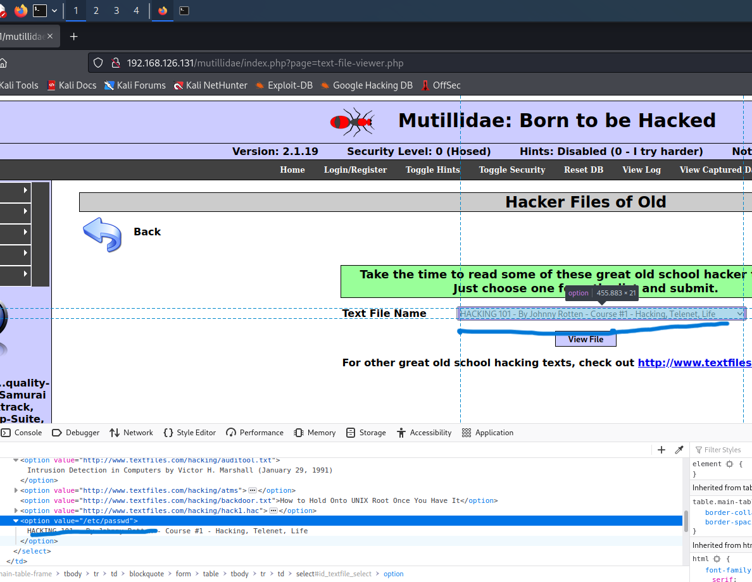
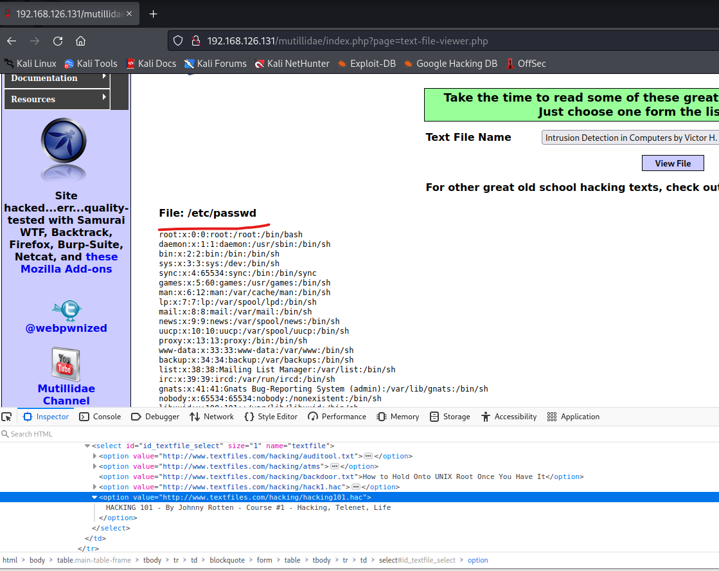
First we found location of the dropdown bar in the inspect element after that in value we changed “/etc/passwd”. This will display or cat the passwd file show the information of users.

Slide 36
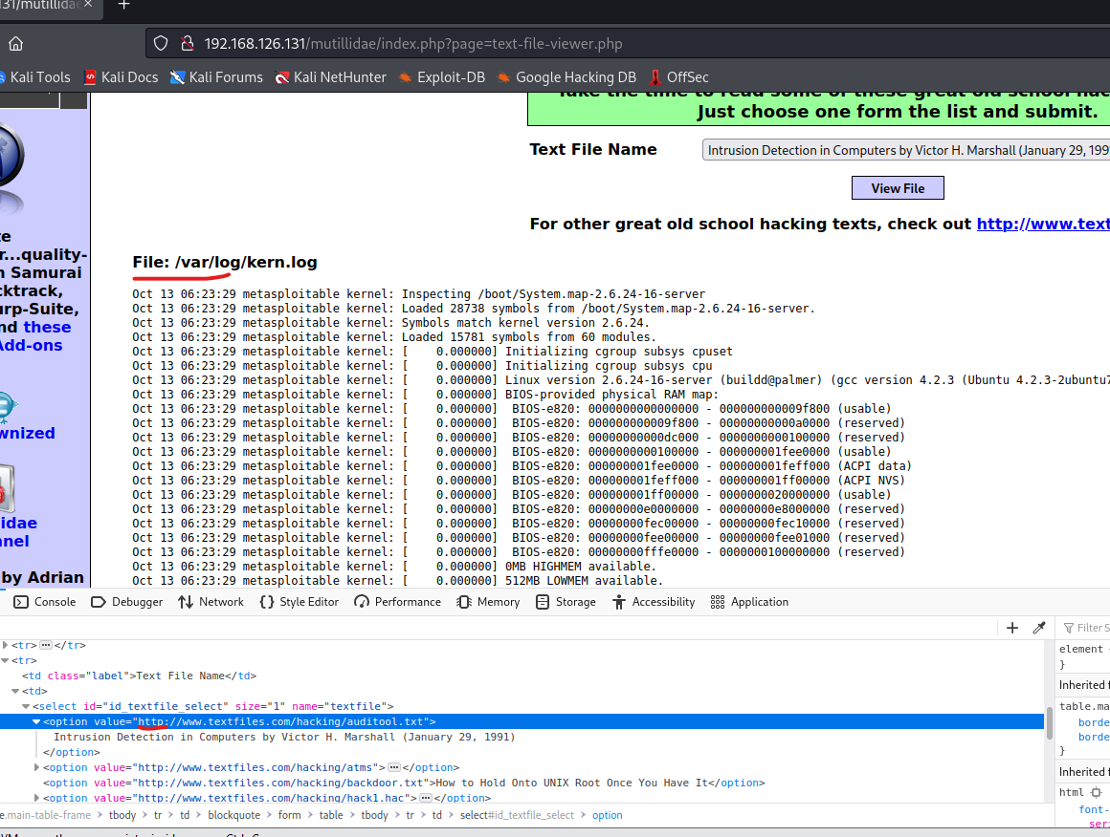
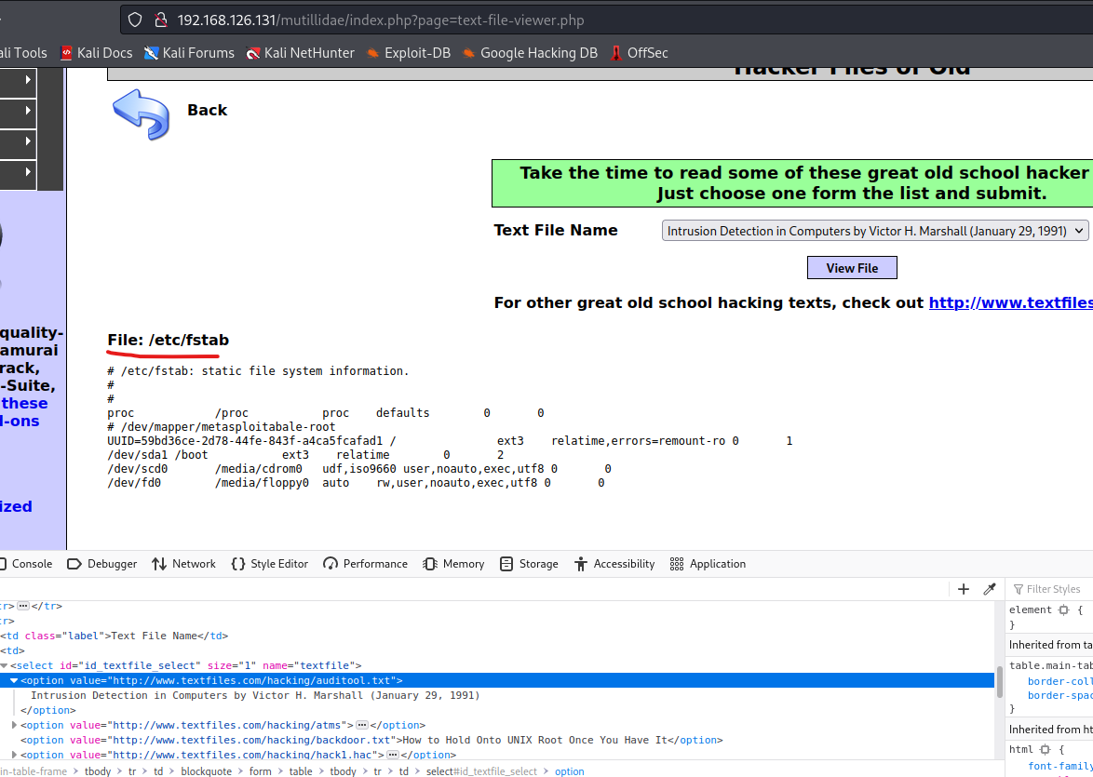
There are so many readable files in Linux, but these are some more we could find.

Slide 37
Prevention
Implenting WAF to prevent website attack.
Using SameSite a cookie attribute (similar to HTTP Only, Secure) which aims to mitigate CSRF attacks.
Verifying Origin with Standard Headers, Identifying the Target Origin.
To prevent from insecure direct object, Avoid Exposing Direct Object References, use an Indirect Reference Map.
Check user access at the Data-Object level, protecting against Directory Traversal.

Slide 38
3. VAPT on Mutillidae Web Database

Slide 39
Mutillidae Web Database
Sno. | Machines | Information | IP’s
1. | Metasploitable (Multtildae Web Database) | http://192.168.137.60/mutillidae/index.php?page=user-info.php | 192.168.137.63

Slide 40
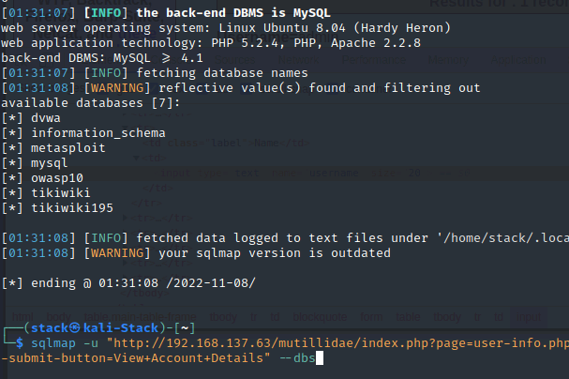
SQLmap
SQL Injection is a code injection technique where an attacker executes malicious SQL queries that control a web application’s database. With the right set of queries, a user can gain access to information stored in databases. SQLMAP tests whether a ‘GET’ parameter is vulnerable to SQL Injection.
The first logged in as admin user, using the credentials acquired from manual SQL injection. By using the command we were able to retrieve databases.
sqlmap -u “http://192.168.137.63/mutillidae/
index.php?page=userinfo.php&username=
admin&password=adminpass&user-info-
submit-button=View+Account+Details” --dbs

Slide 41
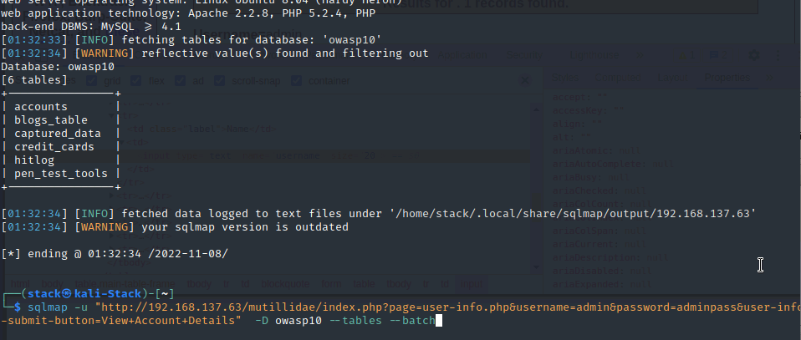
From the information gathered from databases now we are able to retrieve tables presented from following command sqlmap -u “http://192.168.137.63/mutillidae/index.php?page=userinfo.php&username=admin&password=adminpass&user-info-submit-button=View+Account+Details -D owasp10 --tables --batch

Slide 42
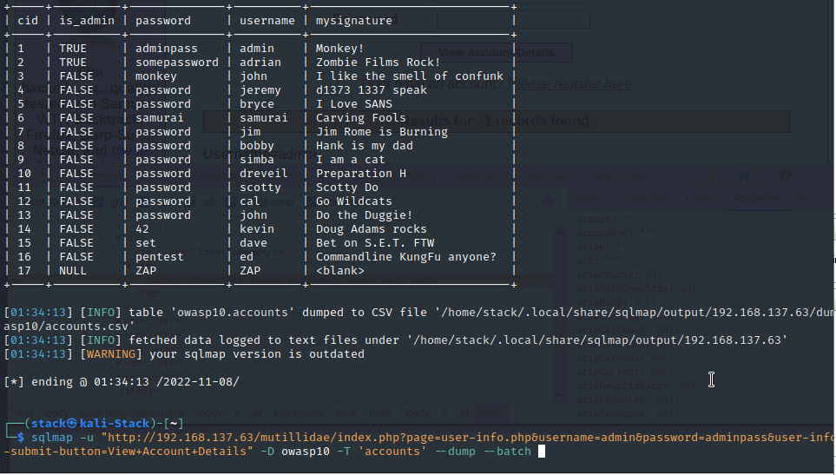
From the information gathered from databases, table information and we retrieve accounts table from following command sqlmap -u “http://192.168.137.63/mutillidae/index.php?page=userinfo.php&username=admin&password=adminpass&user-info-submit button=View+Account+Details-D owasp10 -T ‘accounts’ --dump --batch

Slide 43
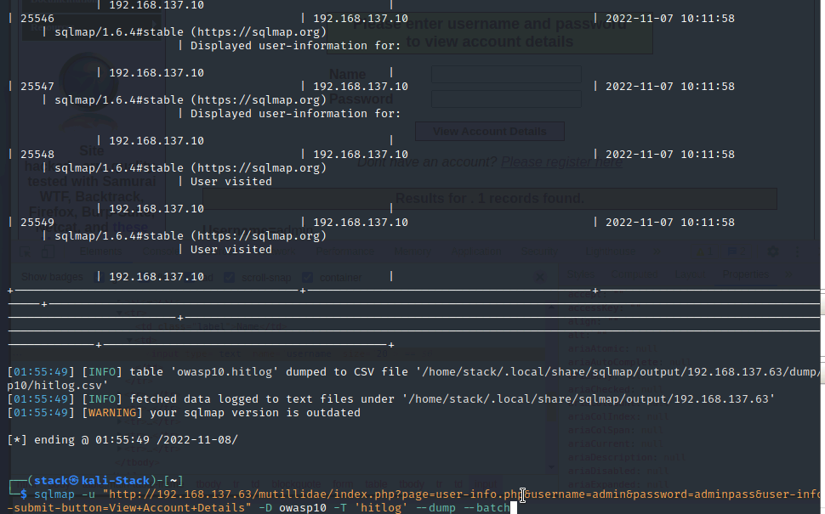
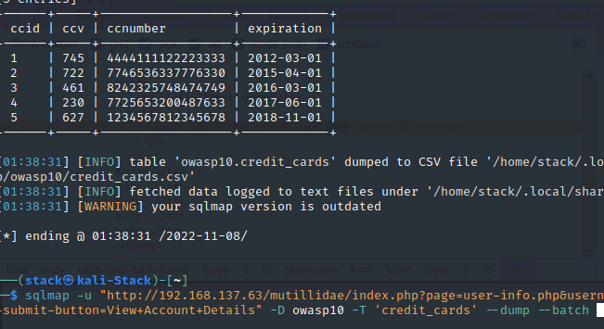
There are some other tables present, here are some important tables. The same commands are used as before the slight change is in –T ‘credit_cards’, ‘hitlog’ are been replaced instead of accounts.

Slide 44
Prevention
Adding Firewall between web-application and database.
Implementing VLan Routing (prevent internal network devices).
Implementing Web Application Firewall (WAF).
Use Query Parameters.
Sanitizing Inputs.
Sanitize File extension and size.
Use whitelists.

Slide 45
Challenges
DNS Spoof
SQL injection
SQLmap

Slide 46

Thank YOU

